Slide 1
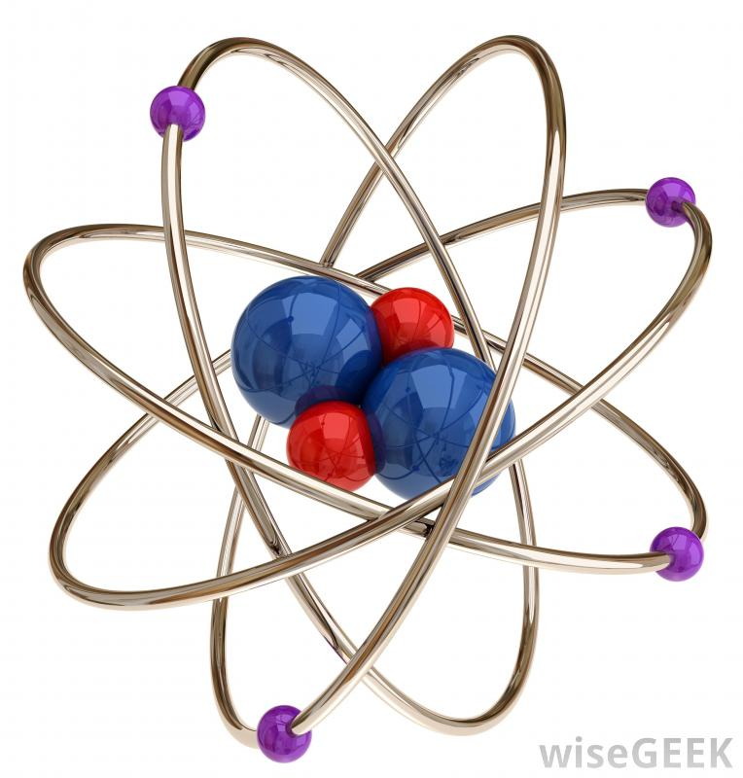
Chapter 5 – Electrons in Atoms
Augustine . S.

Slide 2
Section 5.1 – Models of the Atom
The Rutherford’s model of the atom did not explain how an atom can emit light or the chemical properties of an atom.
Plum Pudding Model Rutherford’s Model

Slide 3
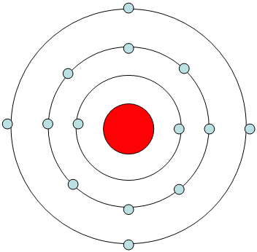
The Bohr Model
Niels Bohr studied the hydrogen atom because it was the most simplistic.
Bohr proposed that an electron is found only in specific circular paths, or orbits, around the nucleus.
Each possible electron orbit in Bohr’s model has a fixed energy. The fixed energies an electron can have are called energy levels.

Slide 4
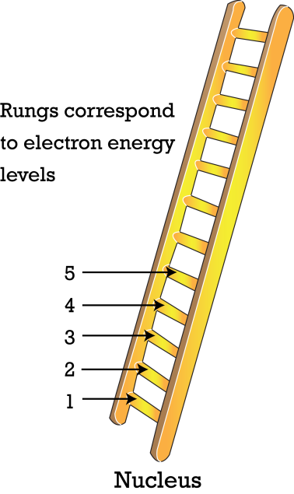
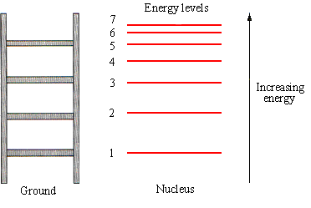
The Bohr Model
The energy levels get closer together as you move farther from the nucleus.
The energy levels also get higher in energy as you move farther from the nucleus.

Slide 5
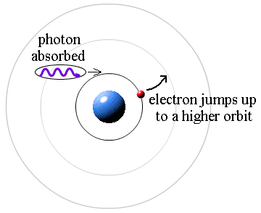
Electrons Jump
Electrons can jump from one energy level to another.
A quantum of energy is the amount of energy required to move an electron from one energy level to another.

Slide 6
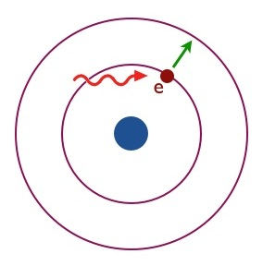
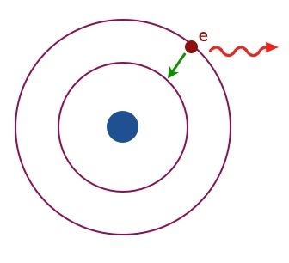
Electrons Jump
An electron must gain energy to jump to a higher energy level.
When an electron has jumped to a higher energy level, it is in an excited state.
An electron must lose energy to fall to a lower energy level.
When an electron is at the lowest energy level possible, it is at ground state.

Slide 7
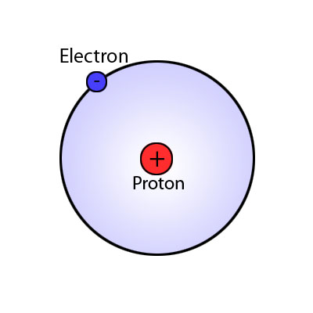
Bohr’s Model Restrictions
Bohr’s model accurately describes the movement of an electron in the hydrogen atom, but it cannot describe the movement of multi-electron atoms.

Slide 8
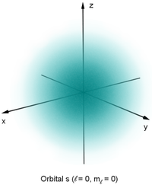
Quantum Mechanical Model
The quantum mechanical model of the atom is based on the mathematical probability of the location of electrons using the Schrodinger equation.
The quantum mechanical model stills has energy levels, but the exact path or orbit of the electron is unknown.

Slide 9
Quantum Mechanical Model
Since the quantum mechanical model is based on the probability of finding an electron, then the orbitals are normally shaded with a fuzzy edge.
An atomic orbital is a region of space in which there is a high probability of finding an electron.

Slide 10
Atomic Orbitals
Within the border of an atomic orbital, there is a 90% chance of finding an electron.
The darker the shading of the orbital, the higher the chance of finding an electron.

Slide 11
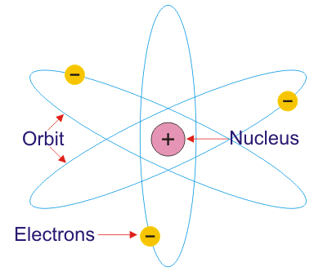
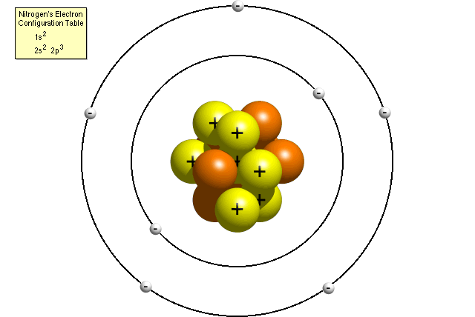
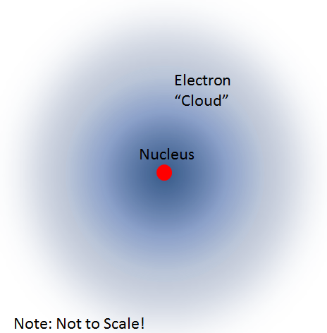
4 Atomic Models
Plum Pudding Model Rutherford’s Model
Bohr’s Model Quantum Mechanical Model
+
90% chance of finding an electron

Slide 12
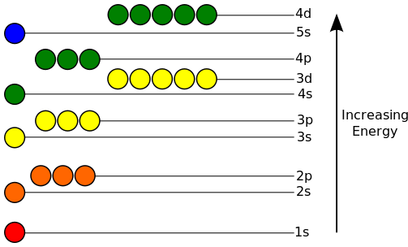
Energy Levels
Each energy level can be composed of multiple sublevels.
Energy levels are assigned a number from 1 to 7 based on the row on the periodic table.
Each sublevel can be composed of multiple orbitals.
The sublevels are assigned a letter: s, p, d, f, or g.
Each orbital can hold a maximum of 2 electrons.

Slide 13
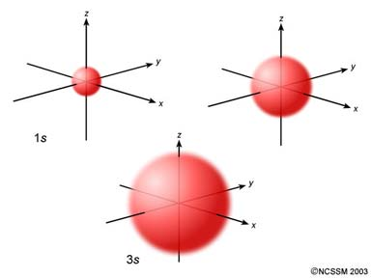
s Sublevel
All s sublevels have 1 orbital and can hold a maximum of 2 electrons.
The number in front of s represents the energy level. As the energy level increases, the size of the s sublevel increases, but it can still only hold 2 electrons. (Ex: 1s, 2s, 3s, etc.)
The s sublevel has a
spherical shape.

Slide 14
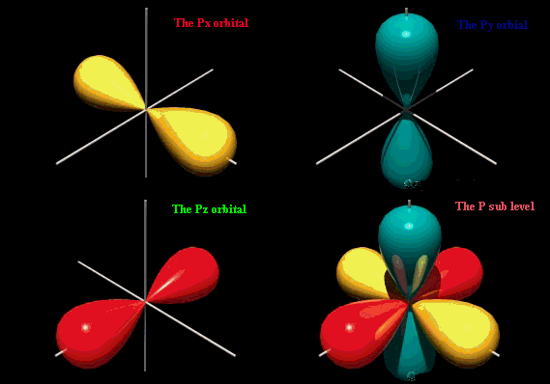
p Sublevel
All p sublevels have 3 orbitals and can hold a maximum of 6 electrons.
The p sublevel has a dumbbell or tear drop shape. Each tear drop is referred to as a lobe.

Slide 15
d sublevel
All d sublevels have 5 orbitals and can hold a maximum of 10 electrons.
The d sublevel has a four leaf clover shape (4 lobes) or 2 lobes and a donut.

Slide 16
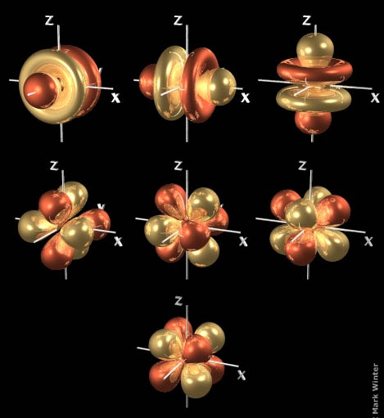
f sublevel
All f sublevels have 7 orbitals and can hold a maximum of 14 electrons.

Slide 17
g Sublevel
All g sublevels have 9 orbitals and can hold a maximum of 18 electrons.
There are not enough elements to fill in the g sublevels yet.

Slide 18
Electrons
Sublevel | # of Orbitals | # of Electrons
s | 1 | 2
p | 3 | 6
d | 5 | 10
f | 7 | 14
g | 9 | 18

Slide 19
Section 5.1 Assessment
Why did Rutherford’s atomic model need to be replaced?
What was the basic new proposal in the Bohr model of the atom?
What does the quantum mechanical model determine about electrons in atoms?
How do two sublevels of the same principle energy level differ from each other?
How can electrons in an atom move from one energy level to another?

Slide 20
Section 5.1 Assessment
6. How many orbitals are in the following sublevels?
a. 3p
b. 2s
c. 4p
d. 3d
e. 4f

Slide 21
Section 5.2 – Electron Arrangement in Atoms
The electron configuration of an atom is the arrangement of the electrons.
There are 3 rules that govern the electron configuration: Aufbau’s principle, Pauli Exclusion principle, and Hund’s rule.

Slide 22
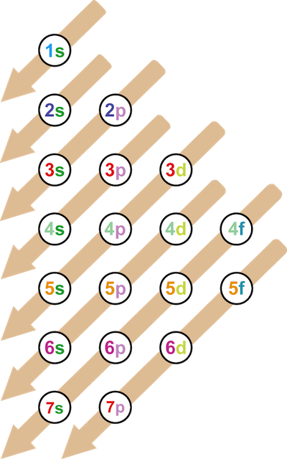
Aufbau’s Principle
Aufbau’s principle states that electrons occupy the lowest energy levels first.
The following is a diagram of the order of the sublevels.

Slide 23
Electron Configuration
Pauli Exclusion principle states that an orbital can hold at most 2 electrons.
When 2 electrons occupy the same orbital, they have opposite spins.
Hund’s rule states that electrons would rather be separate than together in a sublevel with multiple orbitals.

Slide 24
Song to Remember the Rules
To the tune of ABC’s:
Aufbau states that electrons like,
to fill energy levels from low to high.
Pauli exclusion states opposite spins,
and that orbitals hold electrons like twins.
Hunds rule states that electrons care,
about being separate and not in pairs.

Slide 25
Arrow Electron Configuration
When you write the arrow configuration for an element, the first step is to determine the number of electrons by using the atomic number.
For negatively charged particles, add electrons. For positively charged particles, subtract electrons.
The orbitals are represented as dashes above the sublevel.
The electrons are represented by arrows. There can only be one up arrow and one down arrow in each orbital.

Slide 27
Sample Problem
Write the arrow electron configuration for the following:
B
N
V
Zn
__ __ __ __ __
1s 2s 2p
__ __ __ __ __
1s 2s 2p
__ __ __ __ __ __ __ __ __ __ __ __ __ __ __
1s 2s 2p 3s 3p 4s 3d
__ __ __ __ __ __ __ __ __ __ __ __ __ __ __
1s 2s 2p 3s 3p 4s 3d

Slide 28
Practice Problems
Write the arrow electron configuration for the following:
Ti
S
Se
__ __ __ __ __ __ __ __ __ __ __ __ __ __ __
1s 2s 2p 3s 3p 4s 3d
__ __ __ __ __ __ __ __ __
1s 2s 2p 3s 3p
__ __ __ __ __ __ __ __ __ __ __ __ __ __ __ __ __ __
1s 2s 2p 3s 3p 4s 3d 4p

Slide 29
Standard Configuration
When you write the electron configuration in standard form, the number of electrons in each sublevel is written as a power.
You fill in the sublevels in the same order, but after you rearrange the sublevels in number order.
Ex: 1s, 2s, 2p, 3s, 3p, 4s, 3d
1s, 2s, 2p, 3s, 3p ,3d, 4s

Slide 30
Sample Problem
Write the standard electron configuration for the following:
F
Ni
Ga
1s²2s²2p⁵
1s²2s²2p⁶3s²3p⁶4s²3d⁸ → 1s²2s²2p⁶3s²3p⁶3d⁸4s²
1s²2s²2p⁶3s²3p⁶4s²3d¹⁰4p¹ → 1s²2s²2p⁶3s²3p⁶3d¹⁰4s²4p¹

Slide 31
Practice Problems
Write the standard electron configuration for the following:
Ca
Ag
Al
1s²2s²2p⁶3s²3p⁶4s²
1s²2s²2p⁶3s²3p⁶3d¹⁰4s²4p⁶4d⁹5s²
1s²2s²2p⁶3s²3p¹

Slide 32
Noble Gas Configuration (Honors)
When writing electron configurations for large atoms, it is quicker to use the noble gas configuration.
The noble gas configuration only includes the noble gas before the element and the last incomplete energy level.

Slide 33
Sample Problems (Honors)
Write the noble gas configuration for the following:
Te
Y
Ca
[Kr]4d¹⁰5s²5p⁴
[Kr]4d¹5s²
[Ar]4s²

Slide 34
Practice Problems (Honors)
Write the noble gas configuration for the following elements:
Fe
Si
K
[Ar]3d⁶4s²
[Ne]3s²3p²
[Ar]4s¹

Slide 35
Exceptions to the Rules
Sublevels are the most stable when they are full or exactly half-full.
This causes electrons to jump to different sublevels to make the atom more stable.
This jumping does not happen until the 3rd energy level.
There are only 2 exceptions that
you need to memorize.

Slide 36
Sample Problem
Write the standard electron configuration for chromium.
Since 3d is almost half-full, 1 electron from 4s moves to 3d.
1s²2s²2p⁶3s²3p⁶3d⁴4s²
1s²2s²2p⁶3s²3p⁶3d⁵4s¹

Slide 37
Practice Problem
Write the standard electron configuration for copper.
Do not use the exception for any element except Cr and Cu.
1s²2s²2p⁶3s²3p⁶3d¹⁰4s¹

Slide 38
Section 5.2 Assessment
What are the three rules for writing the electron configuration of elements?
Explain why the actual electron configurations for some elements differ from those assigned using the Aufbau principle.
Arrange the following sublevels in order of increasing energy: 2p, 4s, 3s, 3d, and 3p.
Why does one electron in a potassium atom go into the fourth energy level instead of squeezing into the third energy level along with the eight already there?

Slide 39
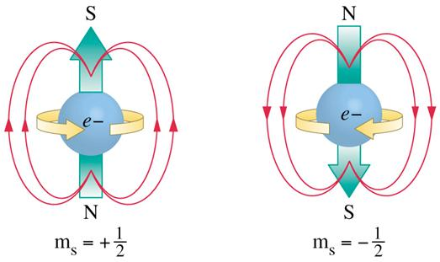
Quantum Numbers (Honors)
Quantum numbers are a set of 4 numbers that can describe any electron.
The four numbers are represented by letters: n, l, m, and s.
n is the principle energy level (1, 2, 3, 4, 5, 6, 7)
l is the sublevel (s = 0, p = 1, d = 2, f = 3, g = 4)
m is the orbital 0 -1 0 1 -2 -1 0 1 2
s p d
-3 -2 -1 0 1 2 3
f
s is the spin ( = 1/2, = -1/2)

Slide 40
Sample Problem (Honors)
Write the quantum numbers for the following electrons:
__ __ __ __ __ __ __ __ __ __ __ __ __ __ __
1s 2s 2p 3s 3p 4s 3d
2, 1, -1, -1/2
0
3, 1, 0, 1/2
3, 2, -2, 1/2

Slide 41
Practice Problems (Honors)
Write the quantum numbers for the following electrons:
the last electron in Mn
The 6th electron
3d⁵ = __ __ __ __ __
3d
3, 2, 2, 1/2
__ __ __ __ __
1s 2s 2p
2, 1, 0, 1/2

Slide 42
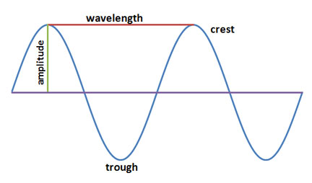
Section 5.3 – Physics and the Quantum Mechanical Model
There are 4 properties of a wave that you need to be able to identify.
The crest is the highest point of a wave.
The trough is the lowest point of a wave.
The amplitude the distance between the rest position and the crest.
The wavelength (λ) is the distance between two crests or two troughs.

Slide 43
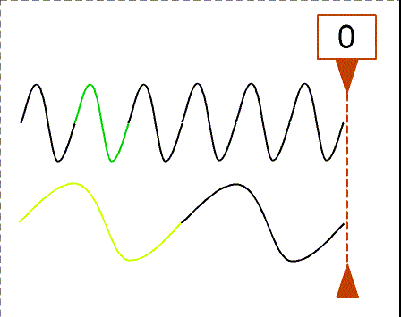
Frequency
The frequency is the number of waves that pass a given point in a certain amount of time.
Frequency (ν) is measured in Hertz (Hz). A hertz is s⁻¹.
c = λν
c = speed of light (3.00 x 10⁸ m/s)
λ = wavelength (m)
ν = frequency (Hz)

Slide 44
Sample Problem
Calculate the wavelength of the yellow light emitted by a sodium lamp which has a frequency of 5.10 x 10¹⁴ Hz.
5.88 x 10⁻⁷ m

Slide 45
Practice Problem
What is the frequency of radiation with a wavelength of 5.00 x 10⁻⁸ m?
6.00 x 10¹⁵ Hz

Slide 46
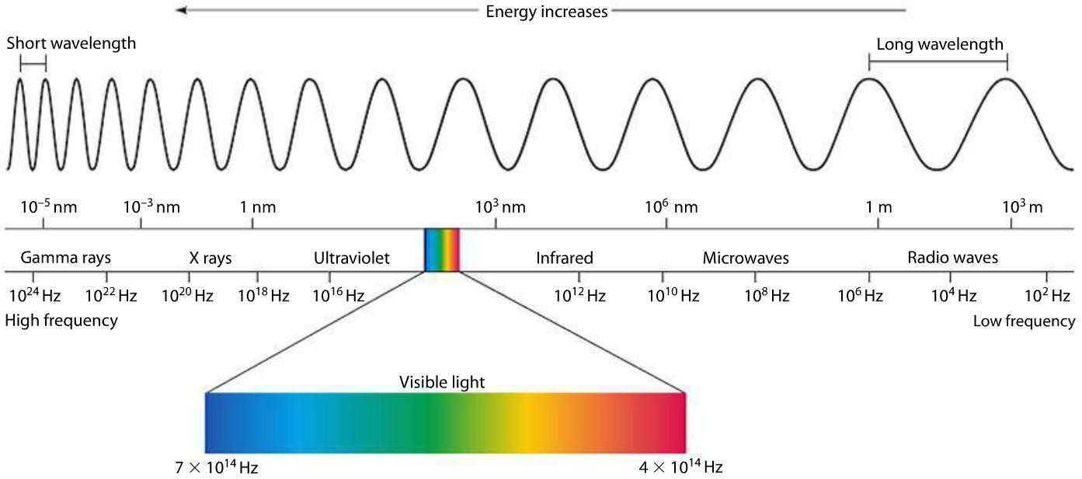
Electromagnetic Spectrum
All electromagnetic waves travel at the same speed, so as wavelength increases, frequency decreases.

Slide 47
Atomic Emission Spectra
The atomic emission spectrum is the set of specific wavelengths that are emitted when an element is electrified.
The atomic emission spectrum is unique for each element just like fingerprints for humans.

Slide 48
Atoms Emit Light
Atoms can emit light when you add heat, electricity, or reaction energy.
The electrons start at ground state. When they absorb energy, they jump to a higher energy level (excited state).
They have to lose the energy to fall back
to ground state, and they lose some of
that energy in the form of visible light.
Atoms emit light when the electrons FALL
to ground state.

Slide 49
Atomic Emission Spectrum

Slide 50
Section 5.3 Assessment
How are wavelength and frequency of light related?
Describe the cause of atomic emission spectrum of an element.

Slide 51
THE END

